Slide 1
Capgemini Values
June, 2019

Slide 2

Workshop Objectives
Explore and share our own Values
Understand Capgemini’s Values
Understand how shared values help shape and deliver lasting business value and personal growth
Notes:
Time on clock:

Slide 3


Values assist us by…
Interpersonal
Compass
Client at heart
Alignment
Catalytic
Mechanism
Sense of Purpose
Providing a framework for how we treat one another at work.
Providing a framework for how we treat our customers.
Helping us make sense of our working life and how we fit in the big picture.
Providing a framework for achieving the vision and increasing the effectiveness of the organisation.
Creating an environment conducive to job satisfaction as well as finding work which is exciting and challenging.
Notes:
Provide an example, how values go beyond a company, instilling values across the ecosystem, clients, suppliers.
Jon Huntsman example. Elaborate.

Slide 4

Organizational and Personal Values & Culture
Culture as a mosaic
Family, Professional Culture
The influence of education,
professional or functional
training and of family values
“Culture is a collective software of the mind, which differentiates members of a group or a category of people”
(Hofstede, 1997)
Corporate Culture
National Culture
(of the place one grew up in)
The influence of the
country where a person was brought up or has lived for long periods of time
The influence of the ways of working in an organisation including values, norms, symbols, stories and believes that are shared among its employees
Notes:
All can be applied at a company, team or individual level – an understanding of all three types is essential when considering cultural and behavioural issues. How people think, feel, act is a result of a lifetime of learning. Much is acquired in early childhood in the social environment in which we grow up.

Slide 5

Our 7 foundation values – at the heart of everything we do
Freedom
Trust
Team Spirit
Our Values
guide our business decisions and shape our culture
Boldness
Modesty
Honesty
Fun
www.capgemini.com/about/group/values-ethics
© Capgemini 2018. All rights reserved |
6

Slide 6
Honesty
Implies…
Loyalty, integrity, uprightness, a complete refusal to use any underhanded method to help win business or gain any kind of advantage.
Honesty
Notes:
Option: highlight departures and consequences right here, with well-known examples from business. Examples, Enron, WorldCom, Satyam
On the other hand, …(give a positive example from Capgemini or other well-known cases)

Slide 7
Boldness
`
Implies…
A flair for entrepreneurship and a desire to take considered risks and show commitment (naturally linked to a firm determination to uphold one’s commitments).
Boldness needs to be combined with a certain level of prudence and clear sightedness.
Boldness
Notes:
Option: positive & negative example
Indra Nooyi. Named CEO of PepsiCo in 2006, Nooyi foresaw the coming shift among consumers, especially the millennial generation, to healthier foods and beverages. She immediately introduced PepsiCo’s strategy “Performance with Purpose,” that focuses on complementing the company’s core soft drink and snack business with healthy foods and beverages. In 2013, PepsiCo was challenged by activist Peltz to split the company, but Nooyi steadfastly refused. Instead, she restructured her leadership team to deliver strong near-term performance while continuing to invest in her transformation strategy.
Nooyi’s arch-rival, Coca-Cola CEO Muhtar Kent, decided instead to concentrate on sugar-based soft drinks while ignoring these obvious trends. As a result, Coca-Cola’s performance has consistently lagged PepsiCo’s. Since 2011, PepsiCo stock is up 70%, while Coca-Cola’s has increased only 15%.

Slide 8
Trust
Implies…
Meaning the willingness to empower both individuals and teams; to have decisions made as close as possible to the point where they will be put into practice.
Trust also means giving priority, within the company, to real openness toward other people and the widest possible sharing of ideas and information.
Trust
Notes:
Optional
College Hires in India changed the work week to Monday-Friday decades back. When the company was young, the India work week was Tuesday to Saturday, to align with customers and onsite teams in the US. The freshers successfully convinced leadership to regularize a Monday-Friday work-week, demonstrating effective support with a proof of concept. Customers loved interacting with the India team that no longer grudged a wasted Saturday and a lonely Monday.

Slide 9
Freedom
Implies…
Independence in thought, judgment and deeds.
Tolerance, respect for others and for different cultures and customs.
Freedom
Notes:
Our Diagem office in Belgium has people from 9 different nationalities! And they get work done, participate in different festivals, and are often confused about the term “cross-cultural collaboration”. “You mean just collaboration? That’s how we work!”
One of our CEO’s welcomed new hires in the following way (irrespective of designation, role, expertise..): Welcome to Capgemini, please build the team you want to work with.
Yes, Capgemini insists we exercise “creative confidence”. The belief that we can change what we don’t like, or do things in a better way.

Slide 10
Fun
Implies…
Feeling good about being part of the company and one’s team.
Feeling proud of what one does, feeling a sense of accomplishment in the search for better quality and greater efficiency.
Fun
Notes:
Rapid Fire way

Slide 11
Team Spirit
Implies…
Simplicity, the very opposite of pretension and arrogance.
It means being discreet, showing common sense, being attentive to others and taking the trouble to be understood by them.
Team Spirit

Slide 12
Modesty
Implies…
Friendship, fidelity, generosity, fairness in sharing the benefits of collective work
Accepting responsibilities and an instinctive willingness to support common efforts.
Modesty

Slide 13




Capgemini Ethics and Values Capgemini named as 2019World's Most Ethical Company® by the Ethisphere Institute for the 7th consecutive year
Business ethics build trust with our clients, shareholders, team members, suppliers and other stakeholders. They provide the right environment and act as a business enabler to support our clients’ ambition and growth.
Our internal “Blue Book” reflects the way our processes integrate our core values.
Our ethics and compliance standards are set out in:
the Code of Business Ethics,
the Anti-Corruption Policy and
the Competition Laws Policy
Notes:
Team Member:
Know and understand our Code of Business Ethics
Act consistently with our Code of Business Ethics, and if in doubt seek guidance from your team leader, human resources manager, our legal department or your Country’s Ethics & Compliance Officer; and
Demonstrate and live our Values, rules of conduct, our behavior and principles of action
Team Leader
Lead by example and maintain, promote and live our Code of Business Ethics in my daily work
Ensure that our Code of Business Ethics is alive within my team
Ensure that I am familiar with the Code of Business Ethics since my team members may come to me for advice and guidance on certain issues in our Code of Business Ethics; and
Identify compliance risks, and make the appropriate decisions regarding issues relevant to my area of responsibility

Slide 14

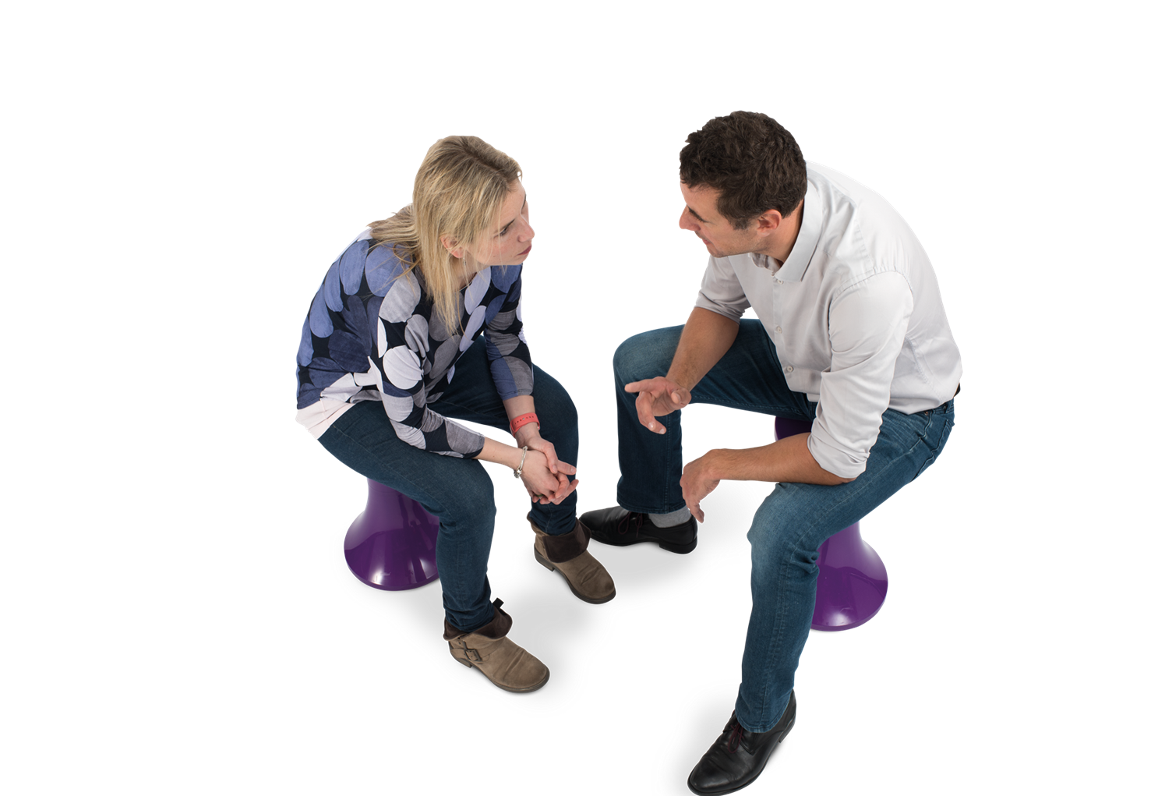
What would you do?

Slide 15

Is this acceptable? Raise your hand to answer
My job requires me to meet with vendors, and I always try to schedule my meetings around lunch or dinner time. The vendors pay the bill. It is very relaxing to discuss business over a meal, and frankly it saves everyone’s time. Is this acceptable?
Notes:
Correct Answer: A. No. Asking a vendor to schedule the meeting during lunch and dinner time especially when they are expected to pay the bill gives rise to a conflict of interest.
B. Yes. It is ok for the vendor to make the bill payment as they have an expectation of continued business.

Slide 16

Is this ok? Raise your hand to answer
I know that my co-worker has taken another job during evenings for a firm that, competes with our company. She always did good work, but lately I’ve noticed that she leaves early to get to her other job. Is this Ok?
Notes:
A. Yes, provided the co-worker has made arrangements with her supervisor to modify her schedule and also informed the ethics office about this part time job.
Correct Answer: B. No. Working with a competitor while employed with our company is a gross violation of the policies and is liable for appropriate actions.

Slide 17
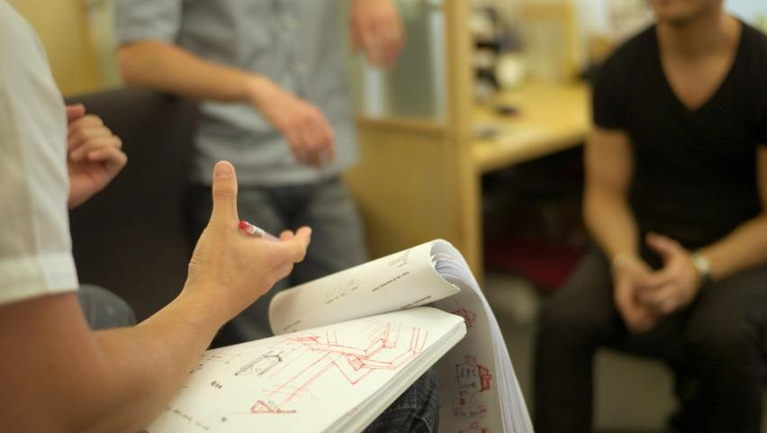
Do I have to disclose? Raise your hand to answer
My friend wants to work at our company and has applied for a job here. I’m on the interview panel. I know he’d do a good job and I want to help him out, but do I have to disclose that I know him?
Notes:
Correct Answer: A. Yes you must disclose the relationship and recuse yourself from participating in the hiring process.
B. I know my friend and hiring him will be an asset for the team. It is in the interest of the company to hire him. Hence I am not disclosing our relationship.

Slide 18
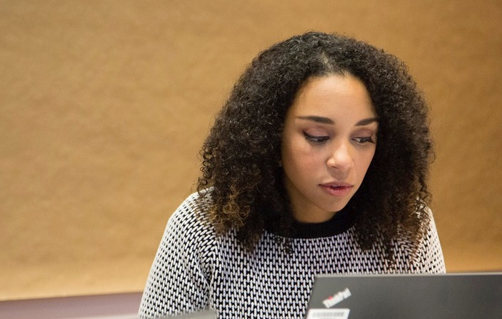
Scenario 1: What would you tell Evania?
Evania is a young, diligent, promising employee, valued by the client and respected by the team.
She was keen to complete a critical delivery, so she forwarded work to her personal email ID and ensured it was done.
The client has reported the incident, blocked her access to the client network and assets and asked for immediate action to be taken by Capgemini.
You are Evania’s best friend at work, you genuinely feel for her and are extremely worried. She comes to you in anguish. What will you tell her?
Notes:
Evania has clearly breached client confidentiality and our info-security policies, although with no intent to harm (from your perspective, not from the client’s). Our work with clients is based on trust and there are no second chances. Clients require us to act on their behalf for such violations.
Question here is, we often tend not to speak our mind and sympathize with colleagues in such situations who we know well and respect.
Are your values strong enough to offer support while being honest (in this case telling Evania she was wrong, professionalism entails awareness of and compliance with NDA)? To set correct precedents, boldly? Will help you win trust and respect too.
What are your thoughts?

Slide 19


Scenario 2: What will you do?
You are eating lunch at the client’s cafeteria and overhear four male Capgemini employees commenting on the appearance of a few females at the client site. They begin ranking the females in terms of their attractiveness. You notice a table nearby of female employees, who can also hear this conversation, and seem very uncomfortable. What should you do?
Nothing – they are on lunch break, so they can discuss whatever they choose.
Move to another table where you can’t hear their discussion.
Tell the male employees that their conversation is not appropriate in the workplace.
Inform your manager and HR.
Should I say something?
Group Presentation | March 2018
Notes:
Correct answers are:
3.Tell the male employees that their conversation is not appropriate in the workplace.
4.Inform your manager and HR.

Slide 20

Scenario 3: What will you do?
Nura is a new employee on your team and she wears a hijab to work every day. A female on the team tells Nura that she should remove her hijab since no one else wears one and it’s distracting. What should Nura do?
Remove the hijab at work, Nura should blend in with her new team to be accepted.
Advise the female that her hijab represents her culture and religion.
Ignore her request, no one else has complained.
Inform her manager and HR.
Notes:
Correct answers are:
2. Advise the female that her hijab represents her culture and religion.
4. Inform her manager and HR.

Slide 21
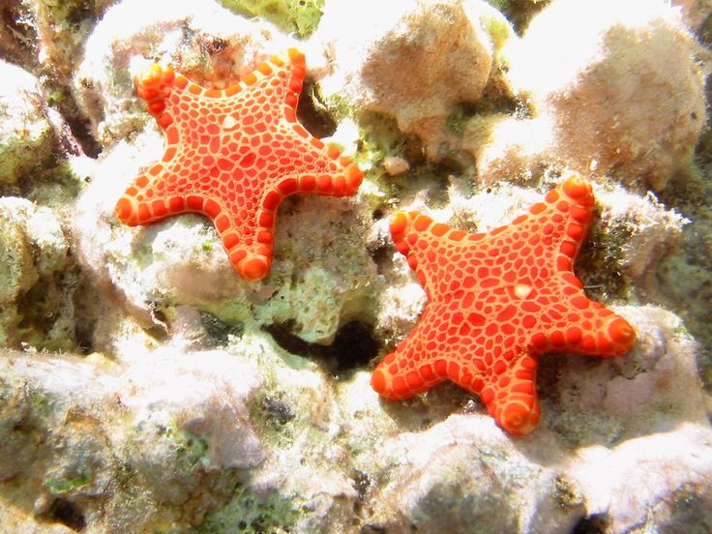
Parting Thought
Living our values in tough times… how much of a difference can I make?
Notes:
Once upon a time, there was a wise man who used to go to the ocean to do his writing. He had a habit of walking on the beach before he began his work. One day, as he was walking along the shore, he looked down the beach and saw a human figure moving like a dancer. He smiled to himself at the thought of someone who would dance to the day, and so, he walked faster to catch up. As he got closer, he noticed that the figure was that of a young man, and that what he was doing was not dancing at all. The young man was reaching down to the shore, picking up small objects, and throwing them into the ocean. He came closer still and called out "Good morning! May I ask what it is that you are doing?" The young man paused, looked up, and replied "Throwing starfish into the ocean." "I must ask, then, why are you throwing starfish into the ocean?" asked the somewhat startled wise man. To this, the young man replied, "The sun is up and the tide is going out. If I don't throw them in, they'll die." Upon hearing this, the wise man commented, "But, young man, do you not realize that there are miles and miles of beach and there are starfish all along every mile? You can't possibly make a difference!" At this, the young man bent down, picked up yet another starfish, and threw it into the ocean. As it met the water, he said, "It made a difference for that one."

